Slide 1
TypeScript
Author: Tran Minh
Contributor: Dat Nguyen

Slide 2
Course Overview

Slide 3
Why do we use TypeScript?
Basic Types & Variable declarations.
Interfaces – Classes – Functions – Generics
Modules
Project Configuration
Q&A

Slide 4
Why do we use TypeScript

Slide 7
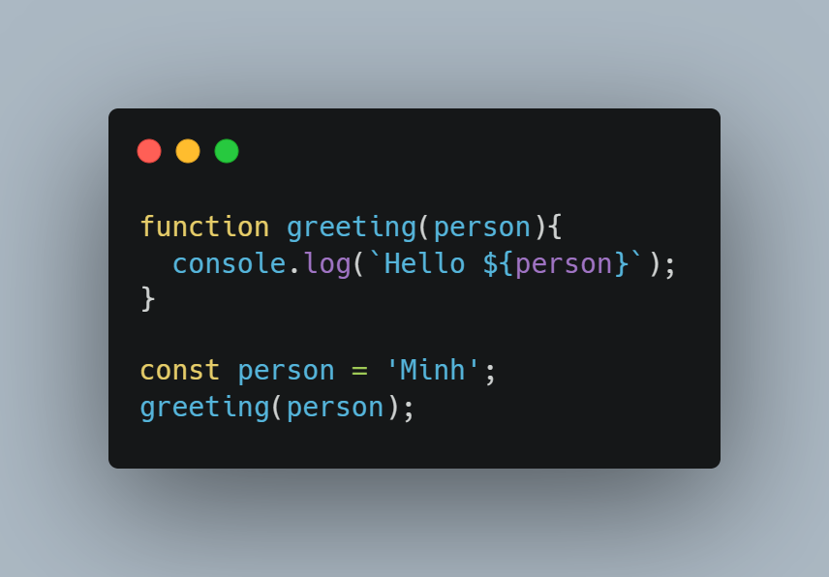
How to run and test TypeScript
Install TypeScript
npm install –g typescript
Building your first TypeScript file:

Slide 8
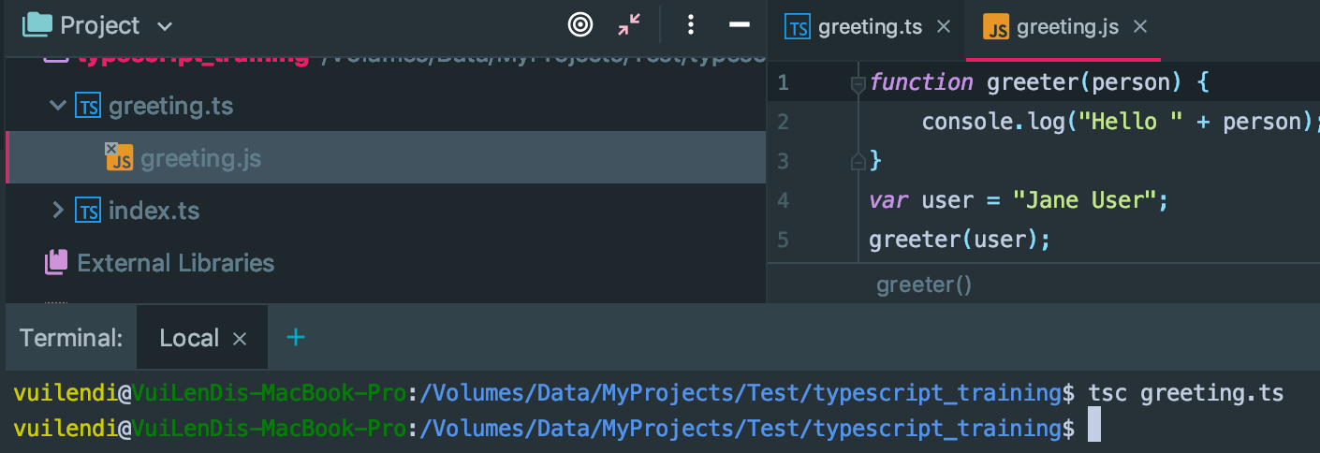
How to run and test TypeScript (2)
Use typescript CLI to build

Slide 9
Basic Types
numbers, strings, structures, boolean values, etc.

Slide 10
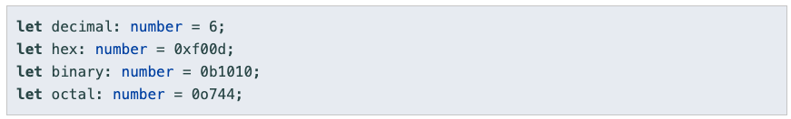
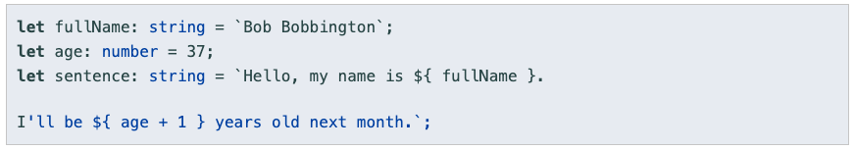
Primitive Types
Number
String
Boolean

Slide 11
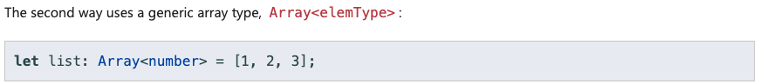
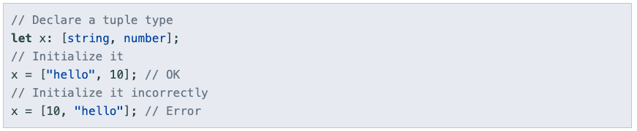
Array
Array
Tuple

Slide 12
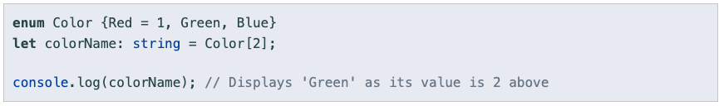
Enum

Slide 13
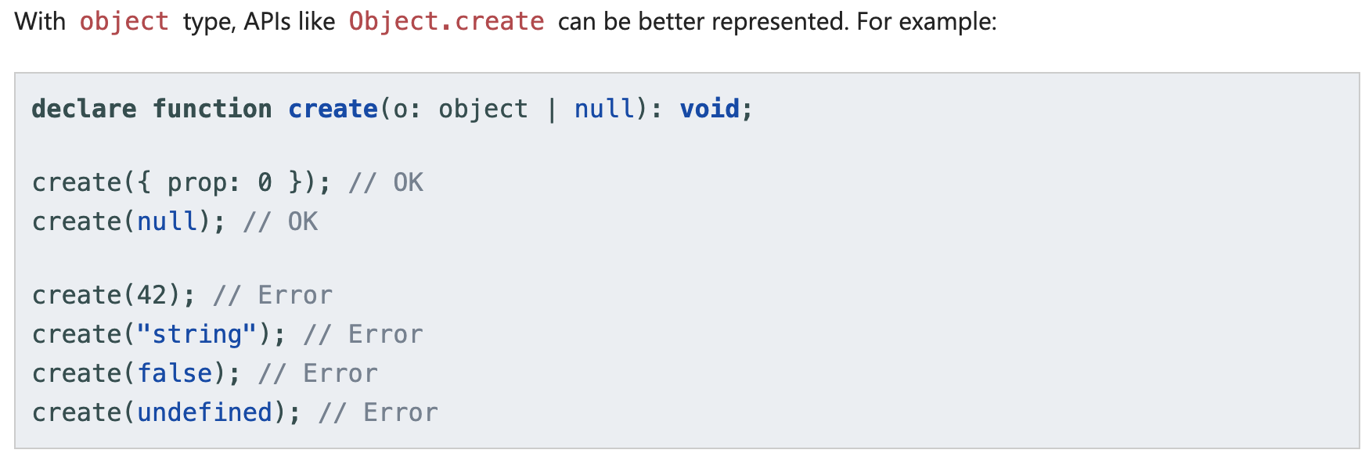
Object

Slide 14
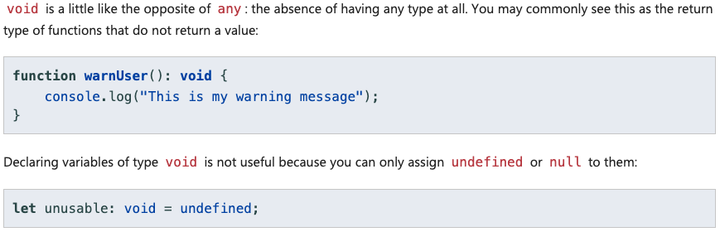
Void

Slide 15
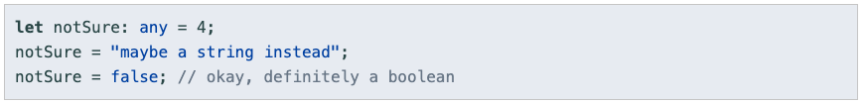
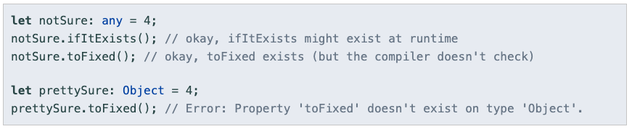
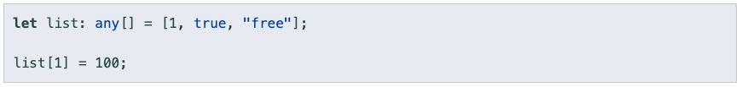
Any

Slide 16
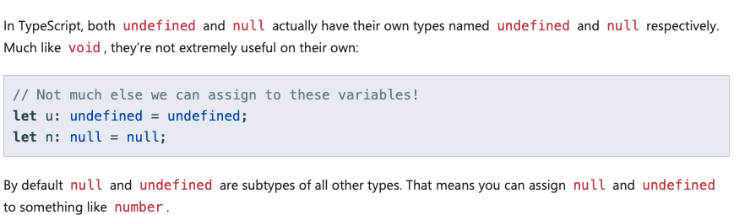
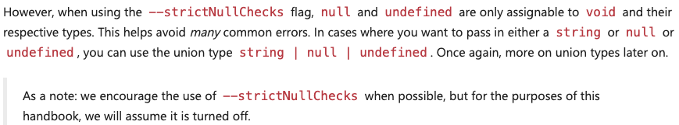
Null and undefined

Slide 17
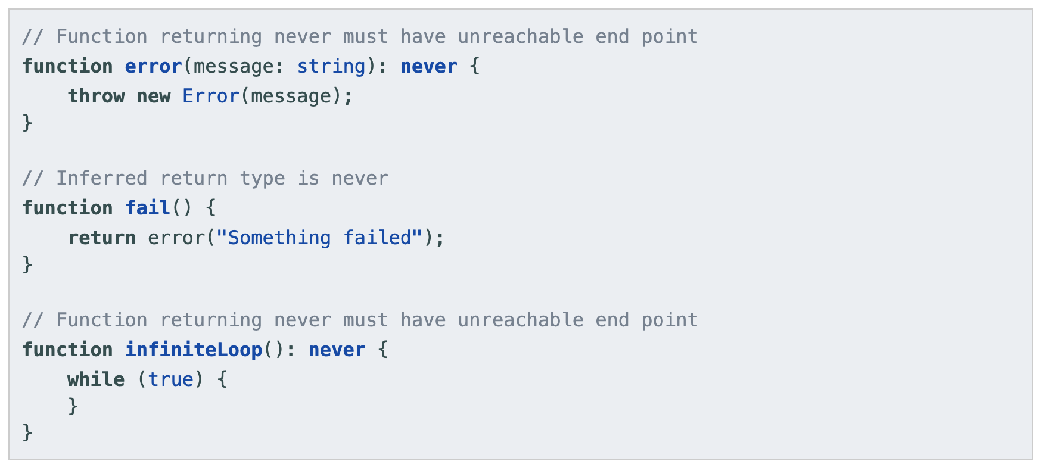
never

Slide 18
Any & never & unknown
any and unknown are the same in terms of what is assignable to them, different in that unknown is not assignable to anything except any.
unknown and never are like inverses of each other. Everything is assignable to unknown, never is assignable to everything. Nothing is assignable to never, unknown is not assignable to anything (except any).
TL;DR;
Any: I don’t care
Unknown: I don’t know
Never: It’s never happened

Slide 19
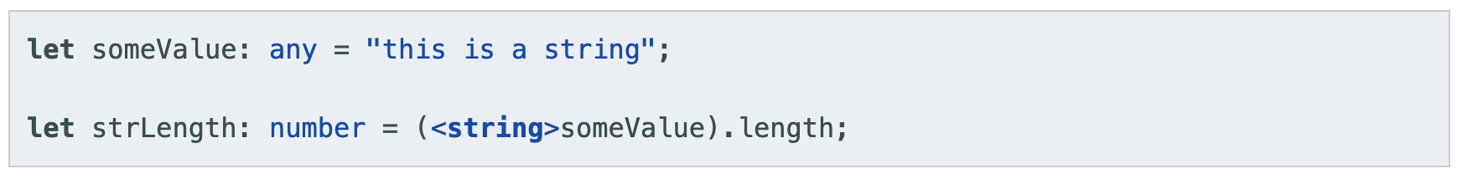
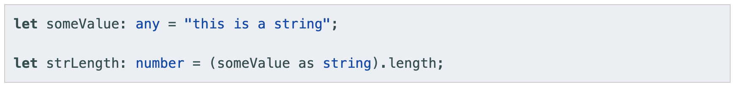
Type assertions
A type assertion is like a type cast in other languages, but performs no special checking or restructuring of data

Slide 20
Var – Let - Const

Slide 21
Declaration
var
var declarations are globally scoped or function/locally scoped.
var variables can be re-declared and updated
let
let is block scoped
let can be updated but not re-declared
const
const declarations are block scoped
const cannot be updated or re-declared

Slide 22
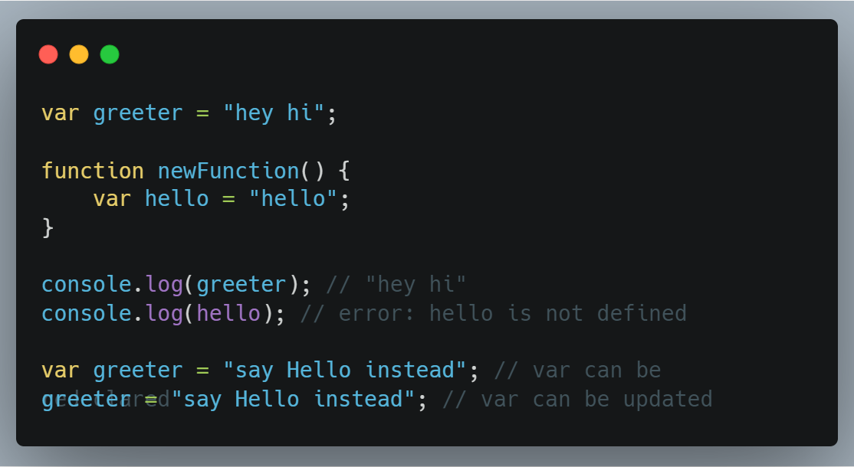
var

Slide 23
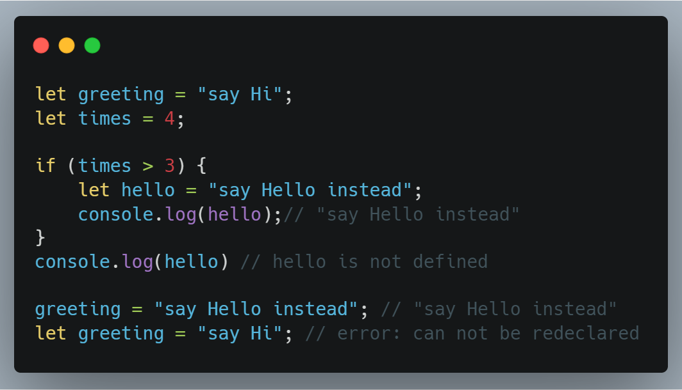
let

Slide 24
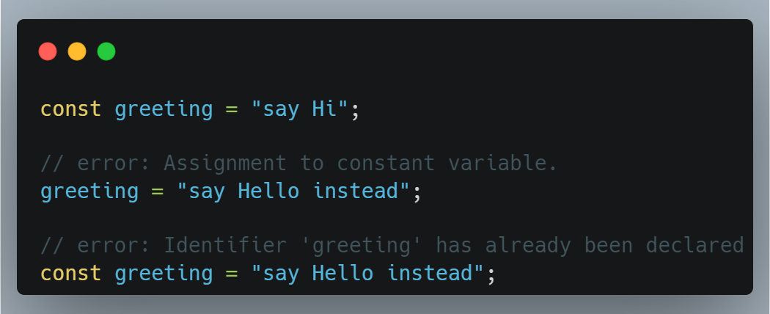
const

Slide 25
Destructuring

Slide 26
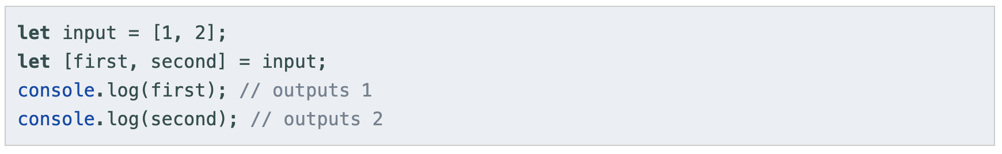
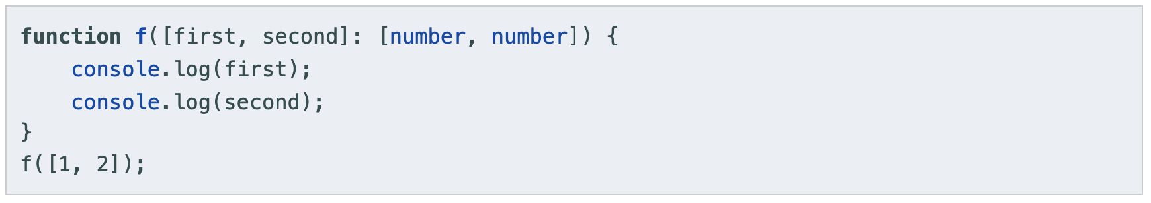
Array Destructuring

Slide 27
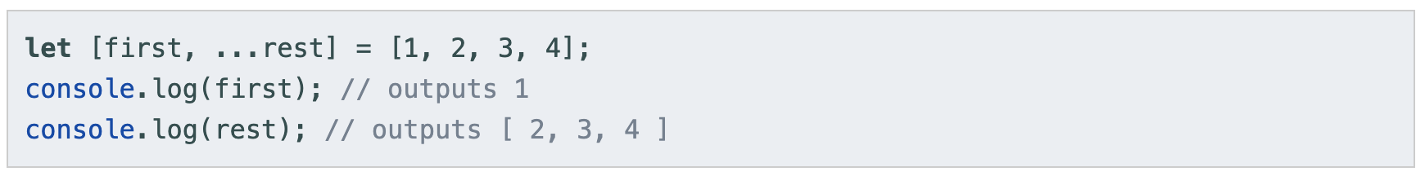
Array Destructuring (2)

Slide 28
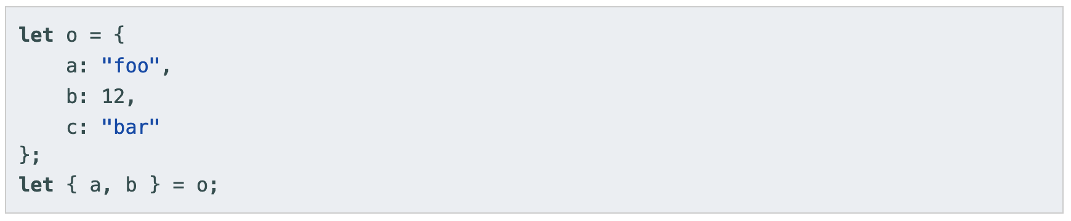
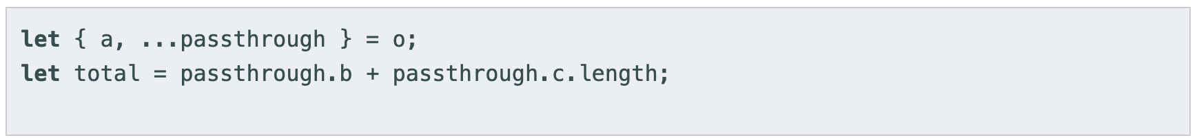
Object Destructuring

Slide 29
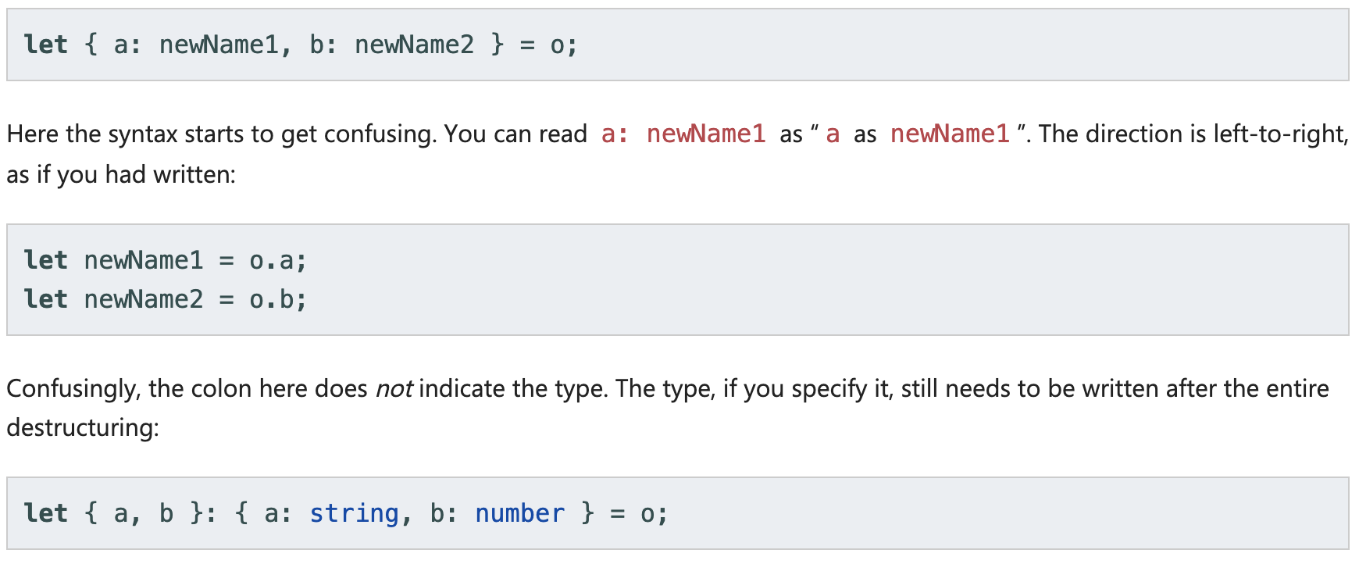
Object Destructuring (2)
Property renaming

Slide 30
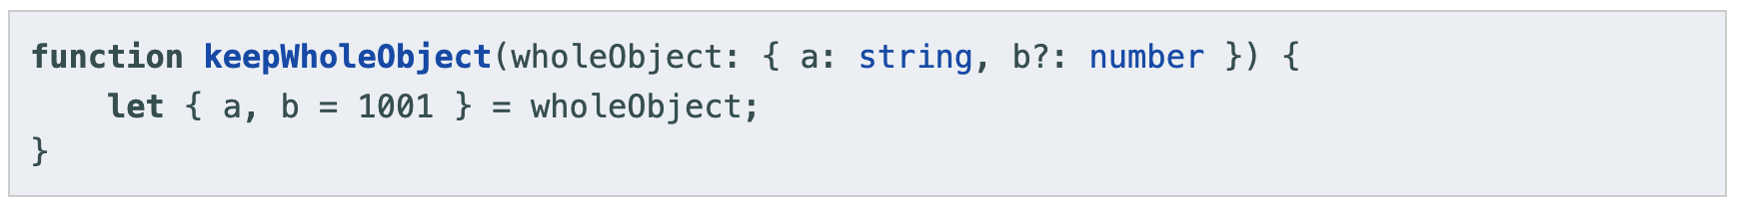
Object Destructuring (3)
Default values

Slide 31
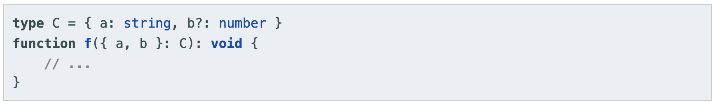
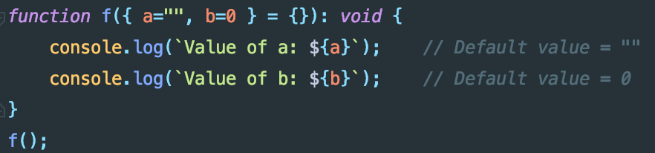
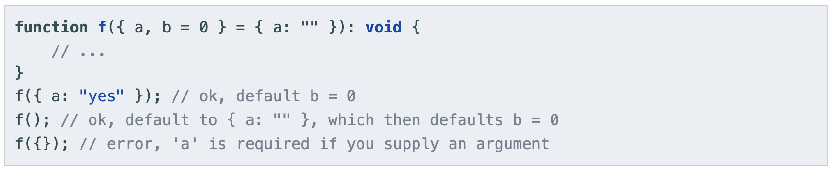
Function arguments

Slide 32
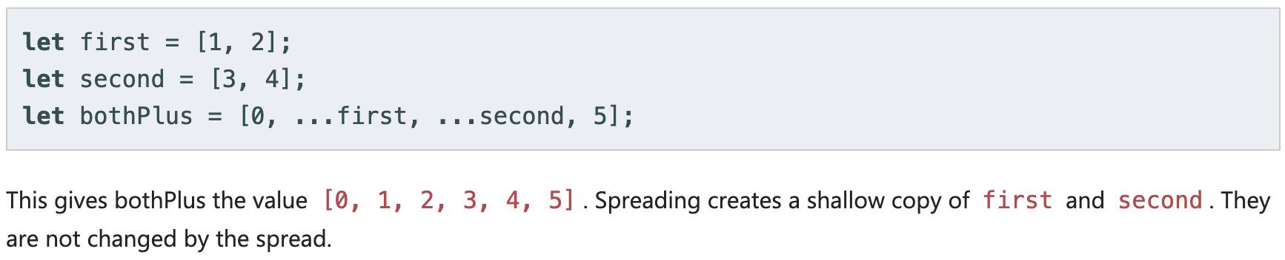
Spread

Slide 33
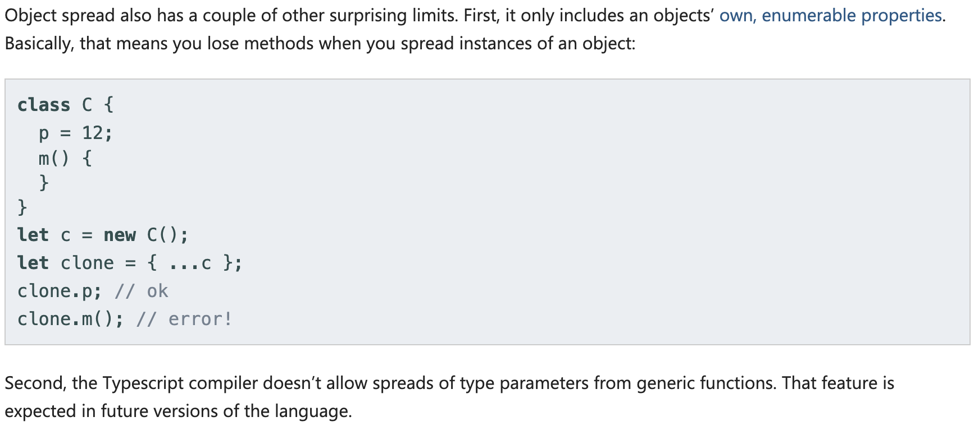
Spread (2)

Slide 34
Interfaces – Classes – Functions

Slide 35
Interfaces

Slide 36
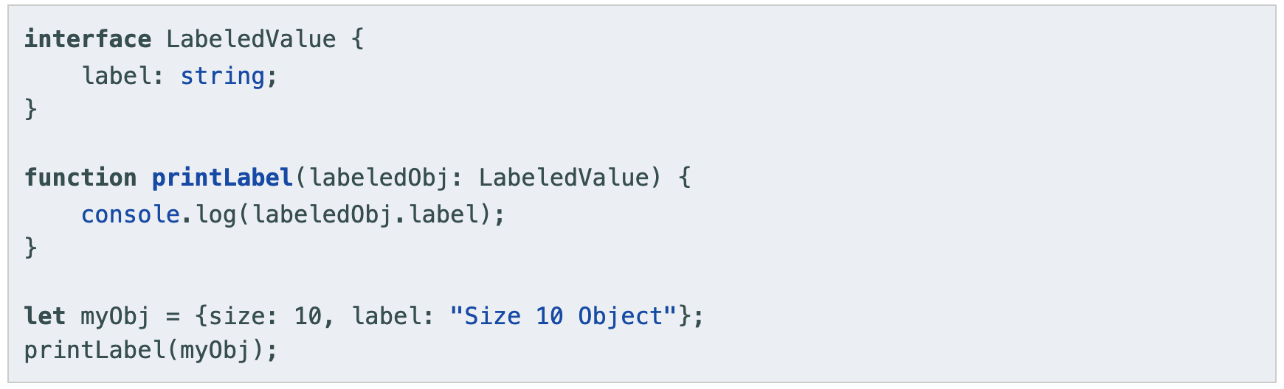
Interfaces

Slide 37
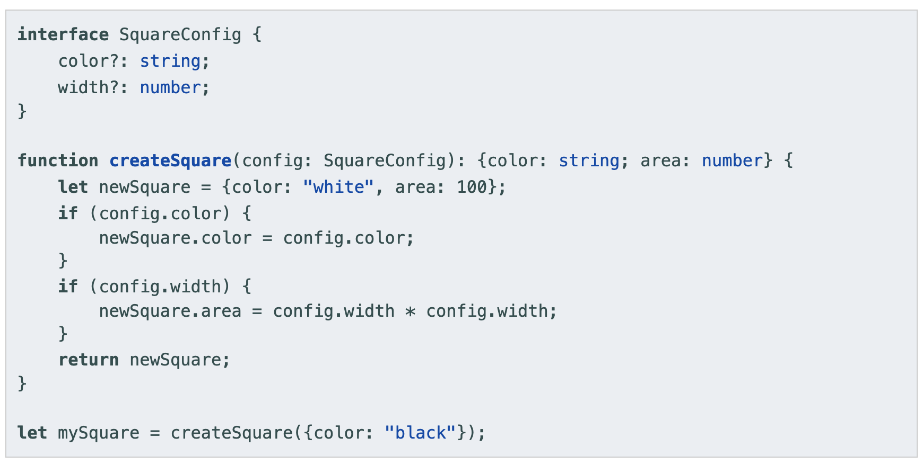
Interface
Optional Properties

Slide 38
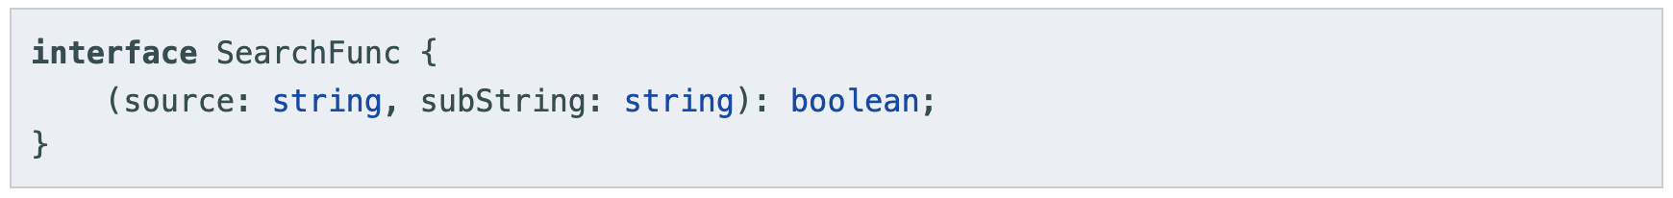
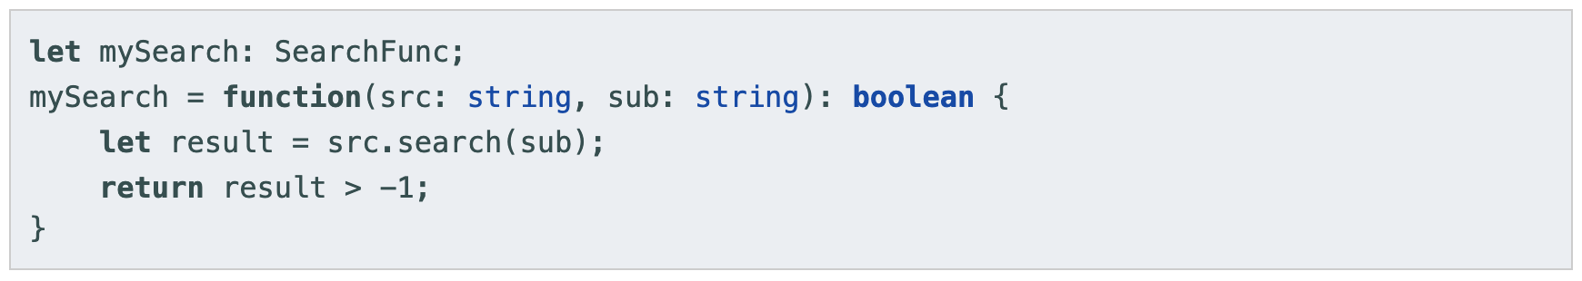
Function

Slide 39
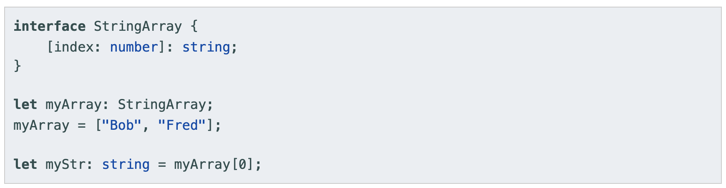
Indexable

Slide 40
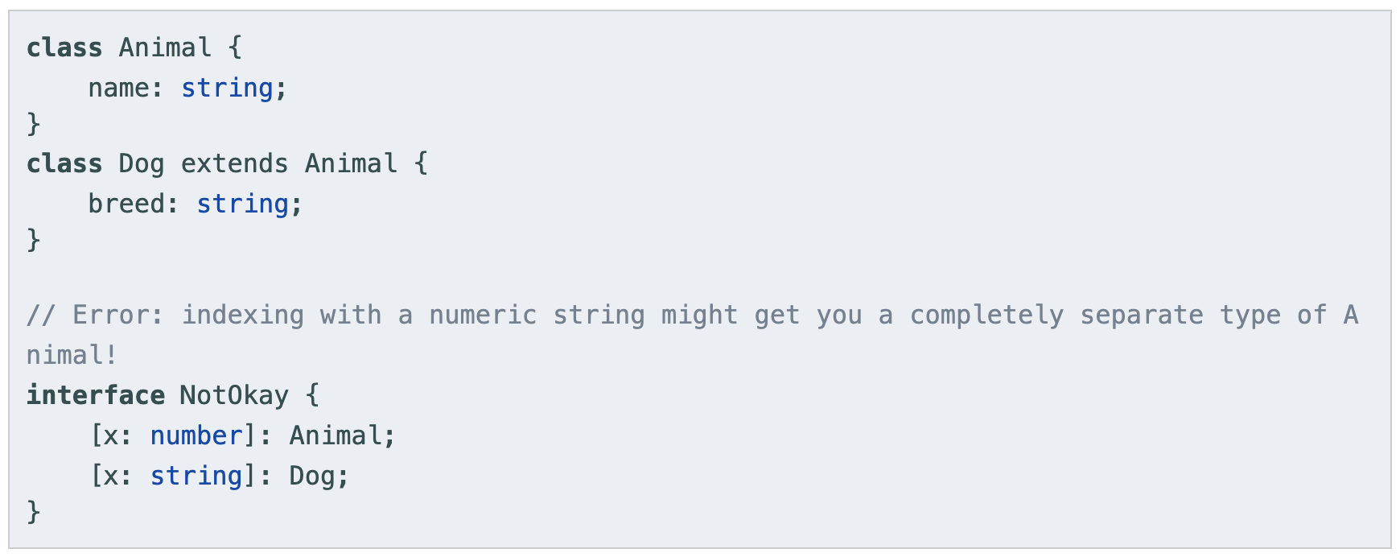
Indexable

Slide 41
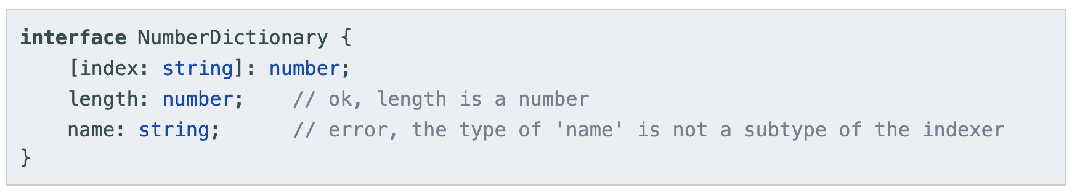
Indexable

Slide 42
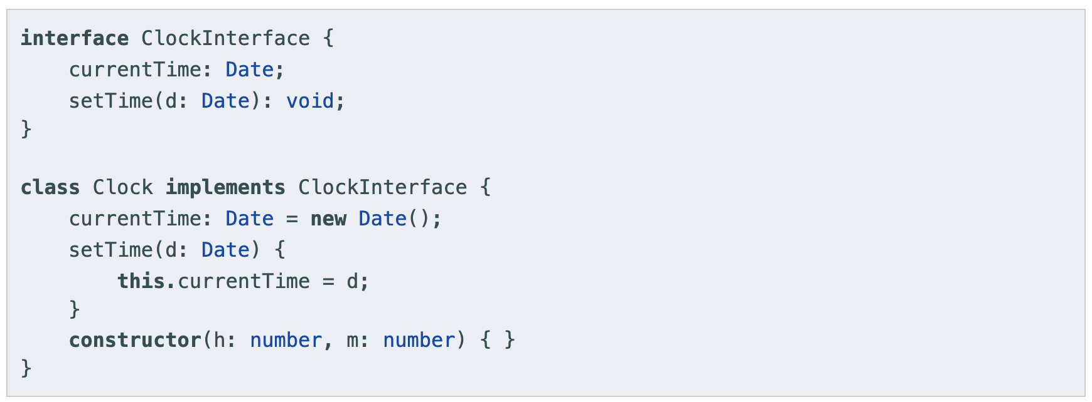
class
Implementing an interface

Slide 43
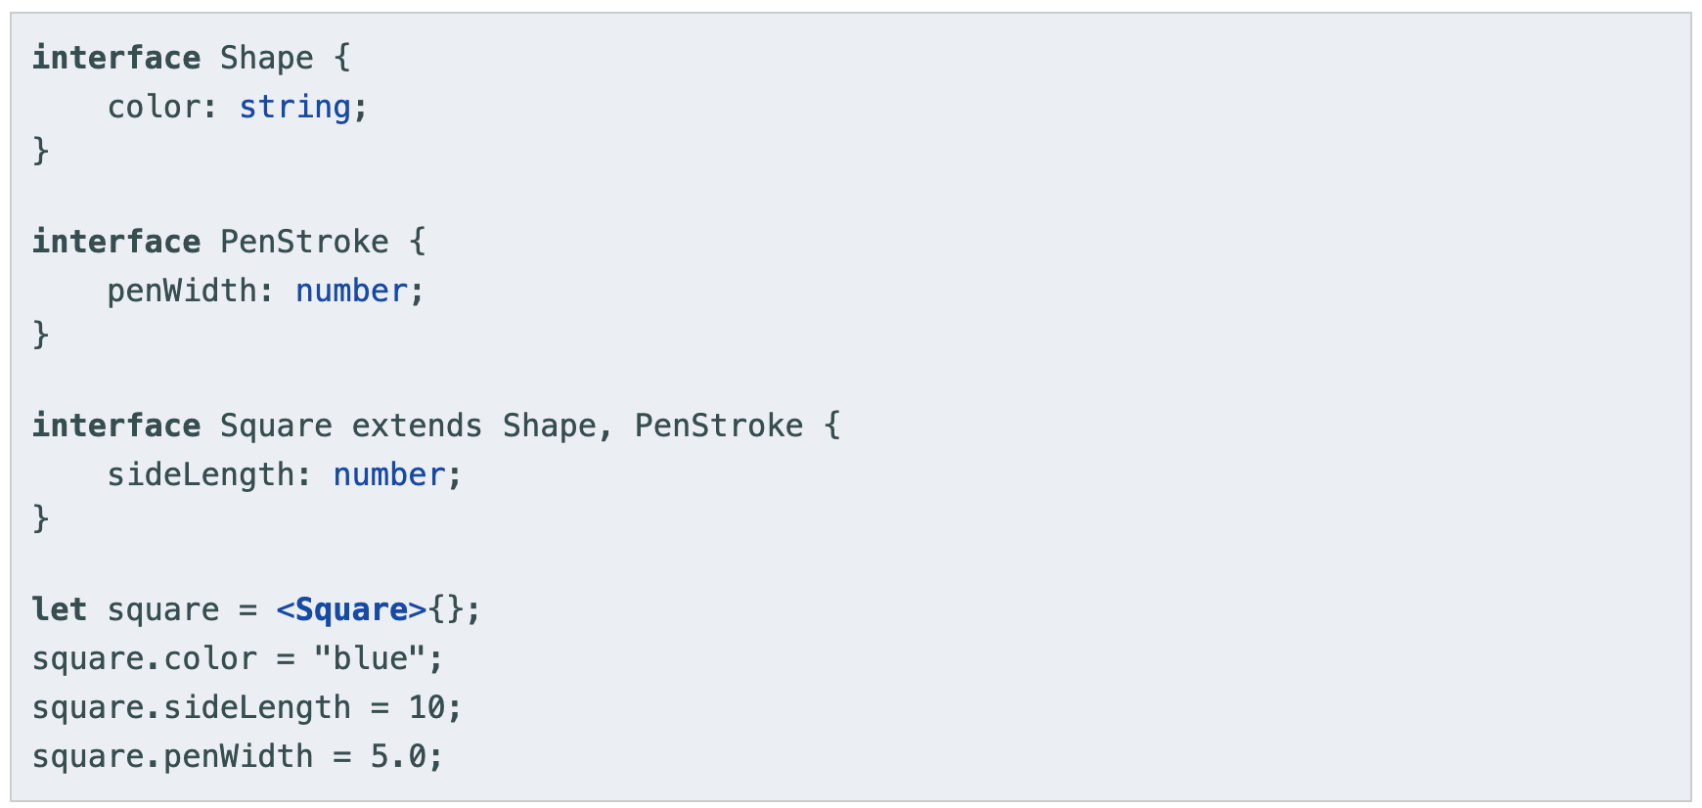
Extending interfaces

Slide 44
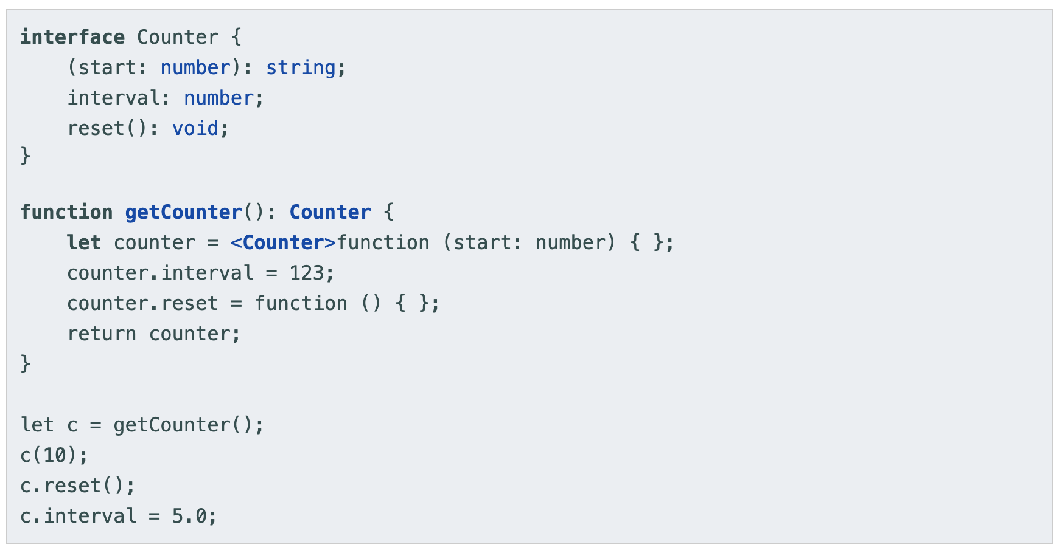
Hybrid Types

Slide 45
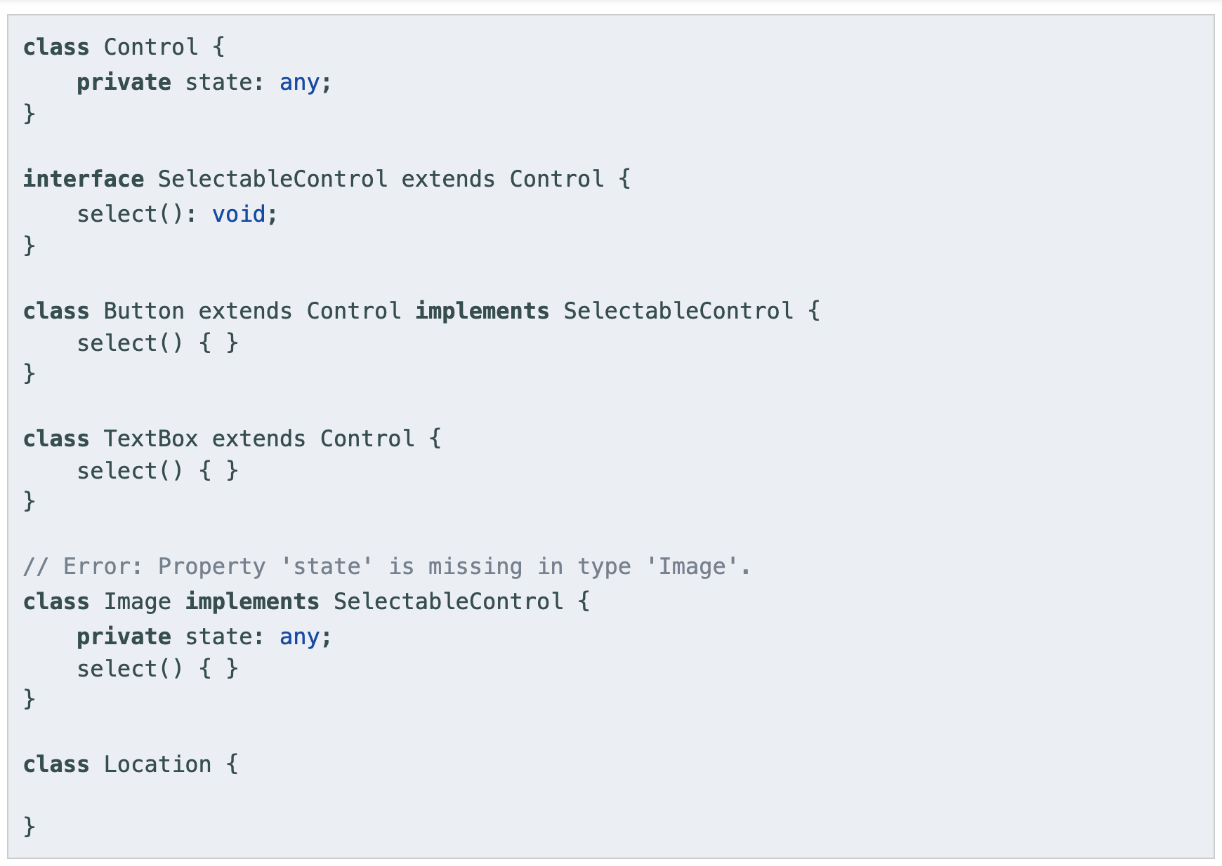
implement

Slide 46
Classes

Slide 47
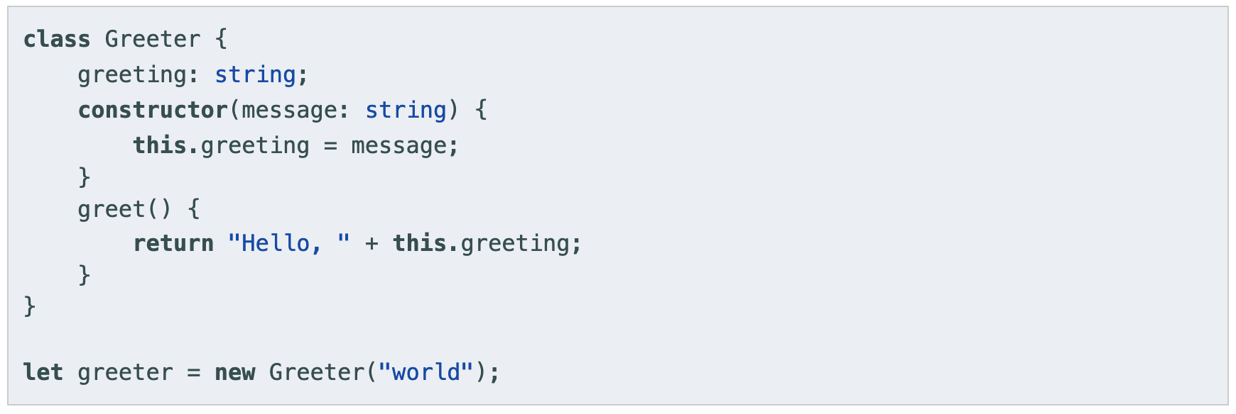
Classes

Slide 48
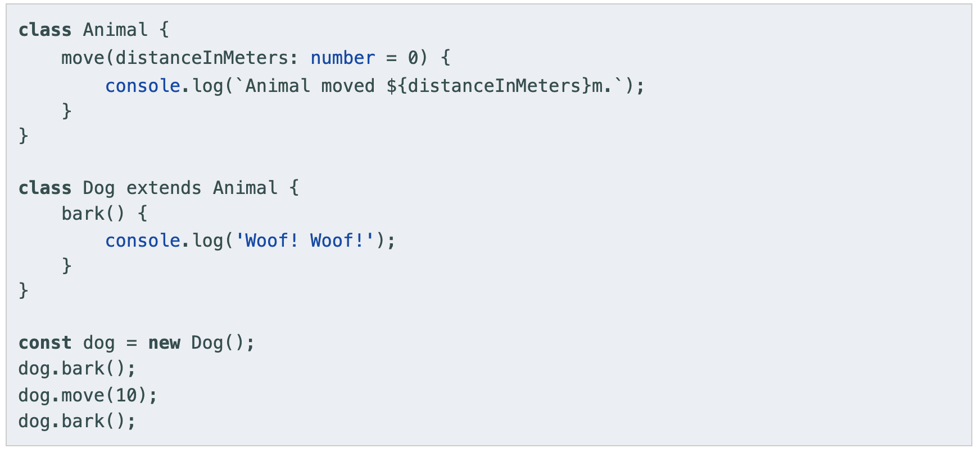
Inheritance

Slide 49
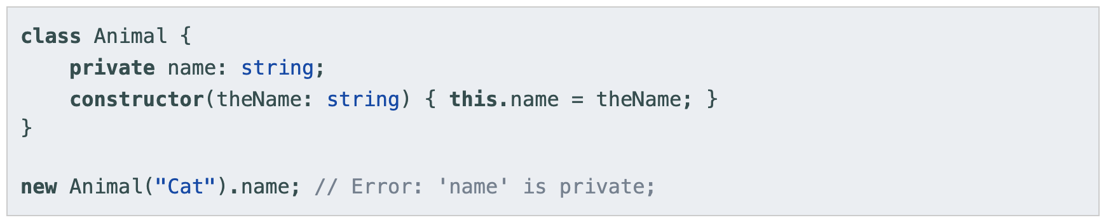
Public, private, and protected modifiers
Public is default
In TypeScript, each member is public is default
Private
When a member is marked private, it cannot be accessed from outside of its containing class
Protected
The protected modifier acts much like the private modifier with the exception that members declared protected can also be accessed within deriving classes

Slide 50
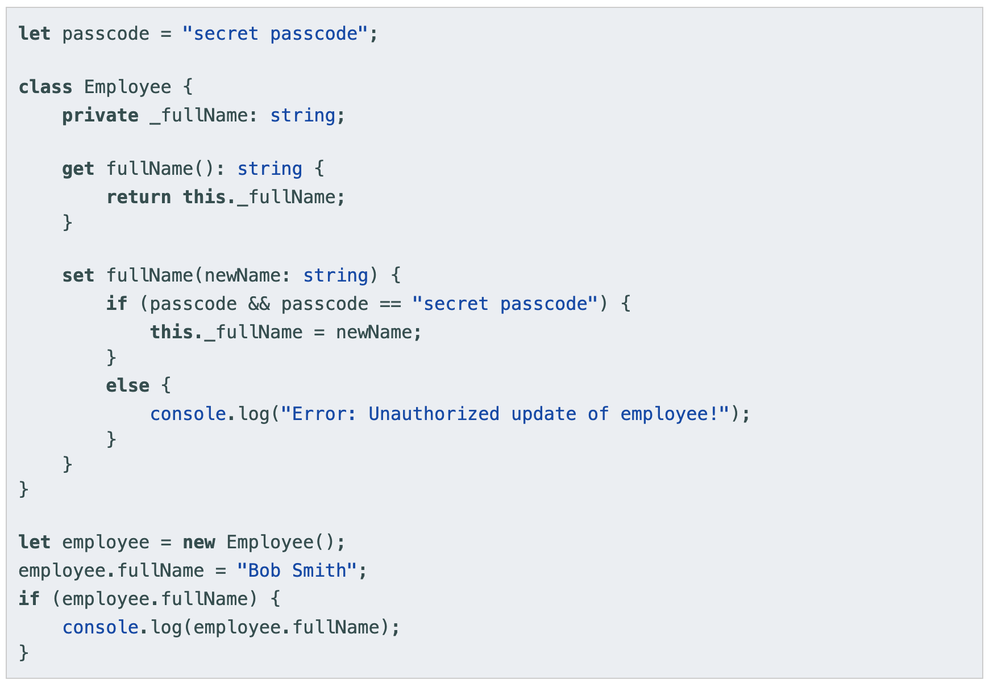
Accessors
TypeScript supports getters/setters as a way of intercepting accesses to a member of an object

Slide 51
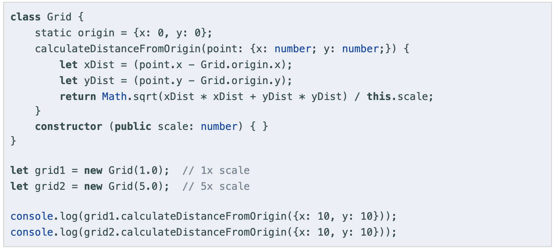
static
Those that are visible on the class itself rather than on the instances

Slide 52
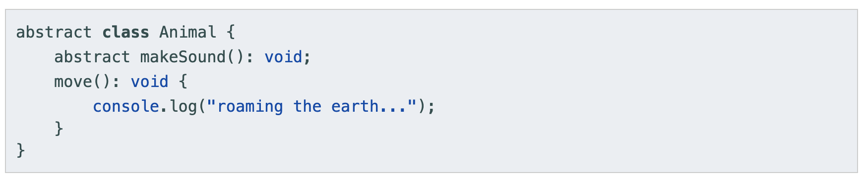
abstract
Abstract classes are base classes from which other classes may be derived
They may not be instantiated directly
An abstract class may contain implementation details for its members
Methods within an abstract class that are marked as abstract do not contain an implementation and must be implemented in derived classes
Both define the signature of a method without including a method body.

Slide 53
Functions

Slide 54
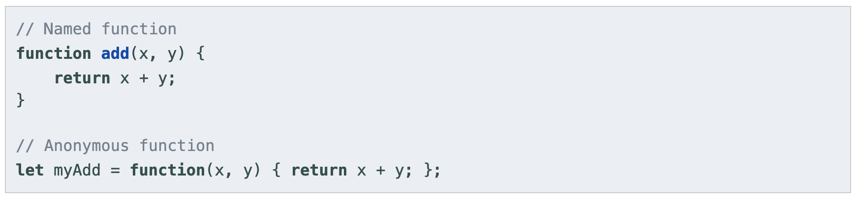

Functions

Slide 55

Optional and default value
In TypeScript, every parameter is assumed to be required by the function. This doesn’t mean that it can’t be given null or undefined

Slide 56

Optional and default value

Slide 57


…rest

Slide 58
Type alias & union types

Slide 59

Alias
We’ve been using object types and union types by writing them directly in type annotations. This is convenient, but it’s common to want to use the same type more than once and refer to it by a single name.

Slide 60

Union types
The first way to combine types you might see is a union type. A union type is a type formed from two or more other types, representing values that may be any one of those types

Slide 61
Type vs interfaces

Slide 62
Type vs Interface: extending
Type
Interface
interface Animal {
name: string;
}
interface Bear extends Animal {
honey: boolean;
name: number; // Error
}
const bear = getBear();
bear.name;
bear.honey;
type Animal = {
name: string;
}
type Bear = Animal & {
honey: boolean;
name: number; // name can be string or number
}
const bear = getBear();
bear.name;
bear.honey;

Slide 63
Type vs Interface: Adding new fields
Type
Interface
interface Window {
title: string;
}
interface Window {
ts: TypeScriptAPI;
}
type Window = {
title: string;
}
type Window = {
ts: TypeScriptAPI;
}
// Error: Duplicate identifier 'Window'.

Slide 64
Generics

Slide 65



Generics

Slide 66


Generics (2)

Slide 67
Modules

Slide 68
Modules
Starting with ECMAScript 2015, JavaScript has a concept of modules. TypeScript shares this concept.
Modules are executed within their own scope, not in the global scope
Declared in a module are not visible outside the module unless they are explicitly exported using one of the export forms
Modules are declarative; the relationships between modules are specified in terms of imports and exports at the file level.

Slide 69

Named exports
Exporting a declaration

Slide 70

Named exports
Export statements

Slide 71


Named export
Re-exports

Slide 72

import
Not Recommend Practice
Though not recommended practice, some modules set up some global state that can be used by other modules. These modules may not have any exports, or the consumer is not interested in any of their exports. To import these modules, use:

Slide 73

Default exports

Slide 74

Default exports

Slide 75

Default exports

Slide 76

Default exports

Slide 77
Project Configuration

Slide 78
Tsconfig.json
The presence of a tsconfig.json file in a directory indicates that the directory is the root of a TypeScript project.
The tsconfig.json file specifies the root files and the compiler options required to compile the project
A project is compiled in one of the following ways:
By invoking tsc with no input files, in which case the compiler searches for the tsconfig.json file starting in the current directory and continuing up the parent directory chain
By invoking tsc with no input files and a --project (or just -p) command line option that specifies the path of a directory containing a tsconfig.json file, or a path to a valid .json file containing the configurations.

Slide 79


Slide 80


Slide 81
Q&A

